Slide 1
Video Game Analysis
GameCo
By Mary Kane
October2024

Slide 2
Overview
This analysis will evaluate the Video Game market behavior from 1980 to 2016 with the intention to Identify the trends in North America, Europe and Japan markets by understanding each region’s preferences, and the publishers behind their sales in the past eight years (2008 - 2016).
The purpose of predicting the market’s preference on genre and platform is to support the development of a new video game by GameCo that succeeds in the market and represents revenue for the company.
Key questions:
What games are more popular?
Have any games increased or decreased in popularity?
What genre of the games are performing the best?
Who are the main Publishers per area?
What is the publishers participation in North America, Europe and Japan.

Slide 3
Understanding the problem
Market Penetration
Swings in the Market
New VG that succeed
The Video Game Industry is constantly evolving, GameCo will release a VG that succeed and bring revenue in 2017. This analysis will help with decision making, investments and local marketing campaigns.
The developers need to select the Main elements to include in the game that will meet Global and Local demand. (Genre preferences, platforms and main competitors in each region.)
Regional Trends: Collecting knowledge from the local perspective, it’s preferences, user’s demographics, opportunities, challenges, similarities and differences between NA, EU and JP

Slide 4
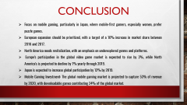
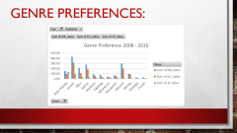
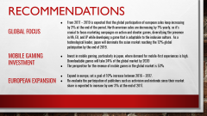



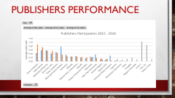

Slide 5
Regional Trends:
Descriptive Analysis

Slide 6
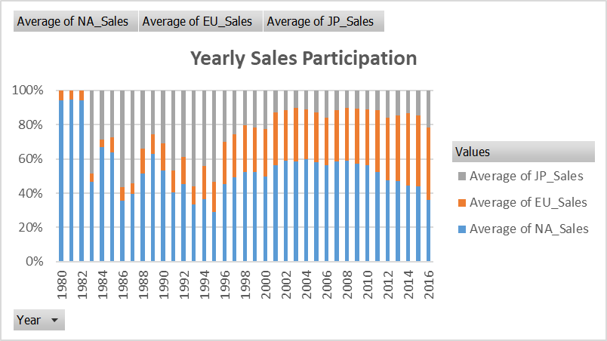
Region participation in sales over time:
Global sales are progressively decreasing, and North America is reducing sales participation, which has opened opportunities to Europe and Japan in the global Video Game market.

Slide 7
North American Market
Gamer population
According to data from 2015, 49% of north americans (specifically in the united states) reported playing video games, meaning roughly half of the population play video games.
Average gamers age: 31y.O.
Key points:
Gender: nearly equal percentages of men (50%) and women (48%) reported playing video games in north america.
European Market
Japanese Market
Region Population 592,296,233
Region Population 745,173,774
Region Population 123,970,000
Year | NA
2008 | 25%
2009 | 24%
2010 | 24%
2011 | 21%
2012 | 24%
2013 | 28%
2014 | 23%
2015 | 17%
2016 | 7%
Total | 27%
Year | EU
2008 | 13%
2009 | 13%
2010 | 14%
2011 | 15%
2012 | 18%
2013 | 23%
2014 | 22%
2015 | 16%
2016 | 8%
Total | 15%
Year | JP
2008 | 4%
2009 | 4%
2010 | 5%
2011 | 5%
2012 | 8%
2013 | 9%
2014 | 7%
2015 | 5%
2016 | 4%
Total | 8%
Gamer Population:
58% of Japanese people played video games in 2015; the
The average gamer age is 36 years
The largest segment of gamers in 2015 were mobile game users.
Key Points: More than half (55%) of mobile-first gamers in Japan are female, and they prefer Puzzle games, while Male gamers prefer Role-Play games (RPG).
Gamer Population
The 53% of Europeans play video games.
The average age of a European video game player is 32 years old.
Key Points:
Approximately 47% of gamers are female, and 53% are male in Europe.
Europe has experienced a rise in sales participation, particularly from 2011 to 2013.
Sales dropped from 28% of global participation in 2013 to just 7% in 2016. This decline indicates market saturation and a need for revitalization.
Sales share increased from 15% to 23%, surpassing North America in 2016 with 8%.
Captured 9% of global sales in 2013 and has maintained a stable market share.
Notes:
North America has seen a decline in sales participation.
Europe represents a growing market with continued investment opportunities.
Japan’s market dynamics present opportunities for innovative game designs.

Slide 8
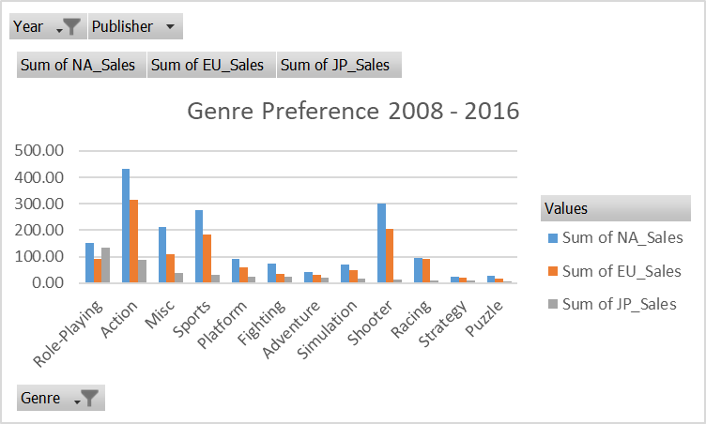
Genre Preferences:
Notes:
North America
Top-selling genres include Action (24%), Shooter, and Sports.
Action games lead the market, indicating a strong consumer preference.
Europe
Similar genre preferences to North America with Action (26%) leading, followed by Shooter (17%).
The shared preference for Action games suggests potential for cross-regional game development.
Japan
Strong preference for Role-Playing Games (RPG) at 32% of sales, followed by Action at 21%.
The focus on RPGs makes Japan a unique market, highlighting the need for local adaptations.

Slide 9
North America’s Top 3 Genre Preference Top-selling genres include Action (24%), Shooter, and Sports. Action games lead the market, indicating a strong consumer preference.
European’s Top 3 Genre Preference Similar genre preferences to North America with Action (26%) leading, followed by Shooter (17%). The shared preference for Action games suggests potential for cross-regional game development.
Japan’s Top 3 Genre Preference Strong preference for Role-Playing Games (RPG) at 32% of sales, followed by Action at 21%. The focus on RPGs makes Japan a unique market, highlighting the need for local adaptations.

Slide 10
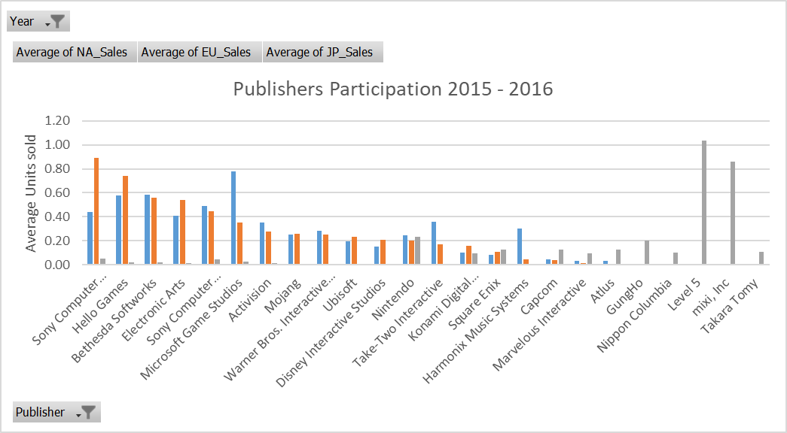
Publishers Performance
Notes:
Japan is a market with specific preferences, and high participation of local publishers focused on new mobile video games. Nintendo is the only publisher participating equally in NA, EU, and JP.
North America has an important demand for Microsoft Game Studios games, and joining Europe, there has been a strong preference for games released by Bethesda Softworks over the past two years.

Slide 11
Publisher’s Performance
North America Key publishers include Microsoft Game Studios, Bethesda Softworks, and Hello Games. These publishers dominate the market from 2015-2016, reflecting consumer preferences.
Europe Strong performance from Sony Computer Entertainment Europe and Hello Games. Bethesda Softworks also plays a significant role in the European market.
Japan Local publishers like Level-5 and Mixi Inc. dominate the market, focusing in mobile gaming and RPGs (Role-Play Games) The contrast with North America and Europe highlights the importance of catering to local tastes.

Slide 12
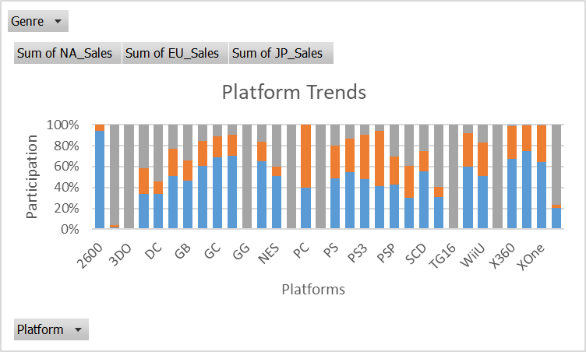
Platform Trends
North America
Sales are driven by PlayStation (PS4), particularly for titles like Call of Duty: Black Ops 3.
The PS4's dominance indicates a strong consumer preference for this platform.
Europe
Similar trends with PlayStation leading sales, especially for popular titles like FIFA 16.
The platform's success underscores the importance of targeting PS4 for future releases.

Slide 13
Platform Trends
Japan
Nintendo WiiU is a key platform, with Splatoon as one of the top-selling games.
3DS and PS4 are popular platforms for other game genres.
The unique platform preferences in Japan highlight the need for tailored marketing strategies.

Slide 14
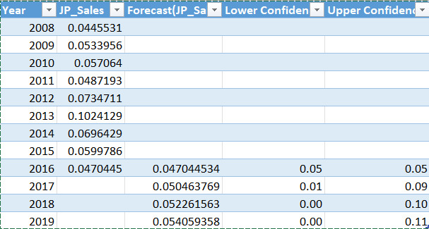
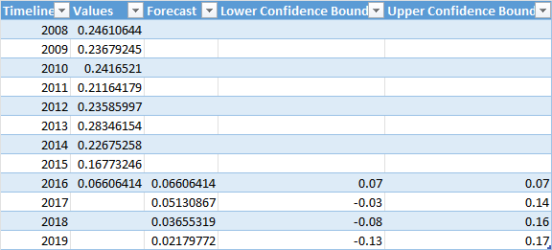
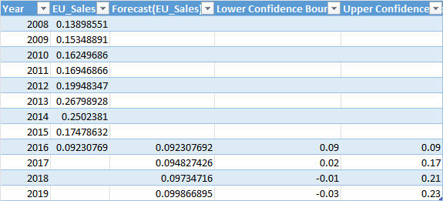
Future Outlook
North america
The market needs revitalization through targeted investments.
Focus on underexplored genres or platforms to stimulate growth.
Games like call of duty and fifa have been localized to fit different cultural contexts, ensuring their popularity across various regions.
Emphasis on action and shooter games.
Europe
Represents a growing market with expansion opportunities.
Increased consumer base and investments in local studios are key drivers.
The video game industry employs over 90,000 people in Europe, and creates new opportunities for writers, designers, game developers, and music producers.
Emphasis in Action Games
Japan
Innovative game designs, including VR and AR, could capture consumer interest.
Mobile gaming is expected to grow in Japan, driven by new game designs and monetization strategies.
Emphasis on Role-Playing Games (RPGs)

Slide 15
Recommendations
Global Focus
From 2017 – 2019 is expected that the global participation of european sales keep increasing by 3% at the end of the period. North american sales are decreasing by 1% yearly, so it’s crucial to focus marketing campaigns on action and shooter games, diversifying the presence in NA, EU, and JP while developing a game that is adaptable to the inclusion culture. As a technological leader, japan will dominate the asian market reaching the 12% global paticipation by the end of 2019.
Mobile Gaming Investment
Invest in mobile gaming, particularly in japan, where demand for mobile-first experiences is high. Downloadable games will take 24% of the global market by 2020
The perspective for the revenue of mobile games in the global market is 53%
European Expansion
Expand in europe, set a goal of 10% increase between 2016 – 2017.
Re-evaluate the participation of publishers such as activision and nintendo since their market share is expected to increase by over 3% at the end of 2017.

Slide 16
Potential Challenges and Strategies
Cultural Differences
Develop games that reflect local narratives and characters to increase engagement.
Focus on genre preferences. Consider blending popular genres.
Adapt marketing campaigns to reflect local culture and values.
Competition from Local Publishers
Invest in local studios. This approach can leverage local culture, preferences, and trends. It can also help navigate different regulatory environments and local expectations regarding content.
Technological adaptation
Utilize emerging technologies such as Virtual Reality to provide fresh experiences to the players.

Slide 17
Conclusion
Focus on mobile gaming, particularly in Japan, where mobile-first gamers, especially women, prefer puzzle games.
European expansion should be prioritized, with a target of a 10% increase in market share between 2016 and 2017.
North America needs revitalization, with an emphasis on underexplored genres and platforms.
Europe's participation in the global video game market is expected to rise by 3%, while North America's is projected to decline by 1% yearly through 2019.
Japan is expected to increase global participation by 12% by 2019.
Mobile Gaming Investment: The global mobile gaming market is projected to capture 53% of revenue by 2020, with downloadable games contributing 24% of the global market.

